Slide 1


2011 Online Retail Performance Dashboard
Comprehensive analysis of monthly revenue, top countries, premium customers and regional demand across 2011, excluding the United Kingdom.

Slide 2

Key Performance Indicators
£628K
£52K
£59K
Total Revenue 2011
Average Monthly Revenue
Peak Month
November (+7% vs October)
12 months excluding UK
Consistent performance throughout
£285K
Top Country
Netherlands leading revenue

Slide 3
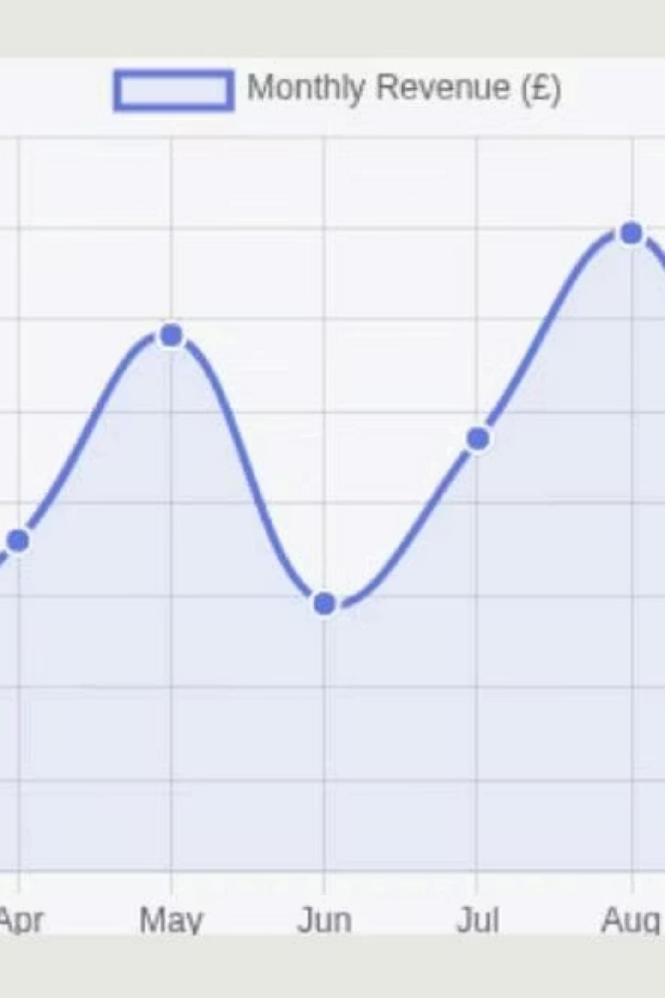
Monthly Revenue Time Series
Revenue fluctuated throughout 2011, peaking at £58,000 in May and reaching a high of £59,000 in November. The trend shows strong performance in the latter half of the year.

Slide 4
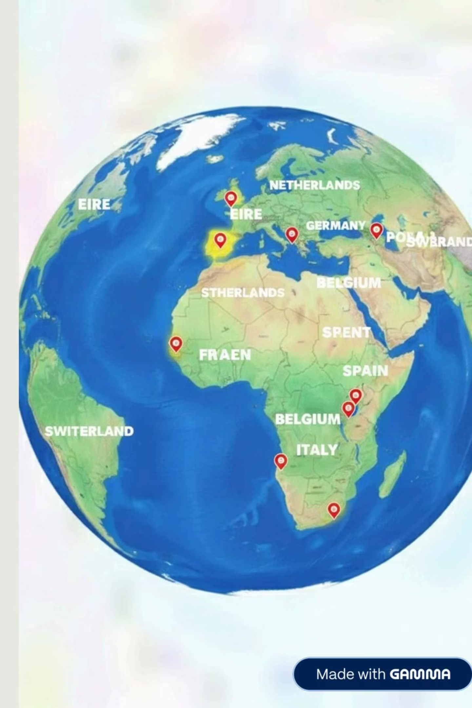
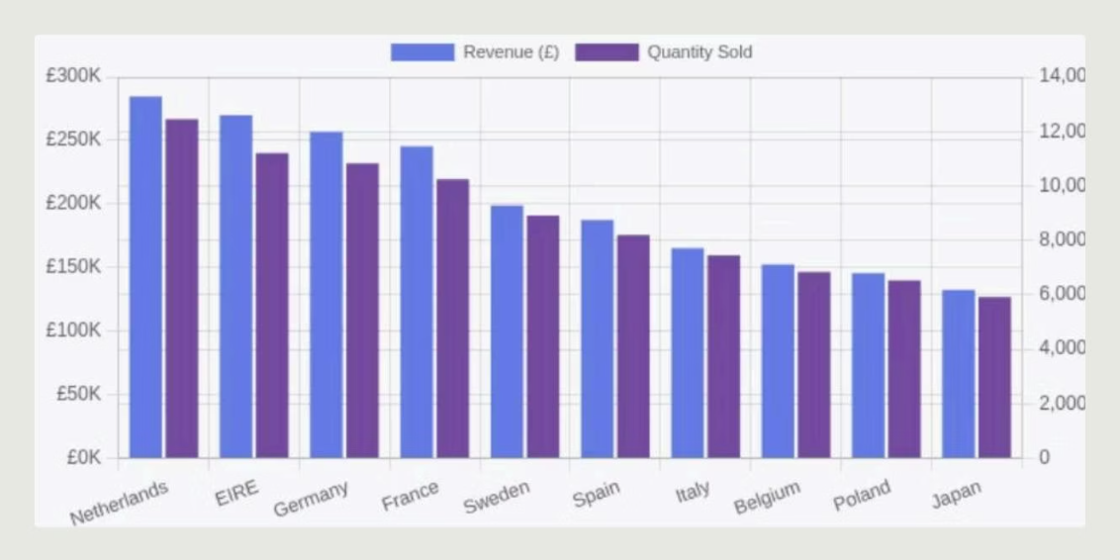
Top 10 Countries: Revenue & Quantity
Netherlands leads with the highest revenue and quantity sold, followed by EIRE, Germany, France and Sweden. The top three countries account for 46.6% of total revenue.

Slide 5
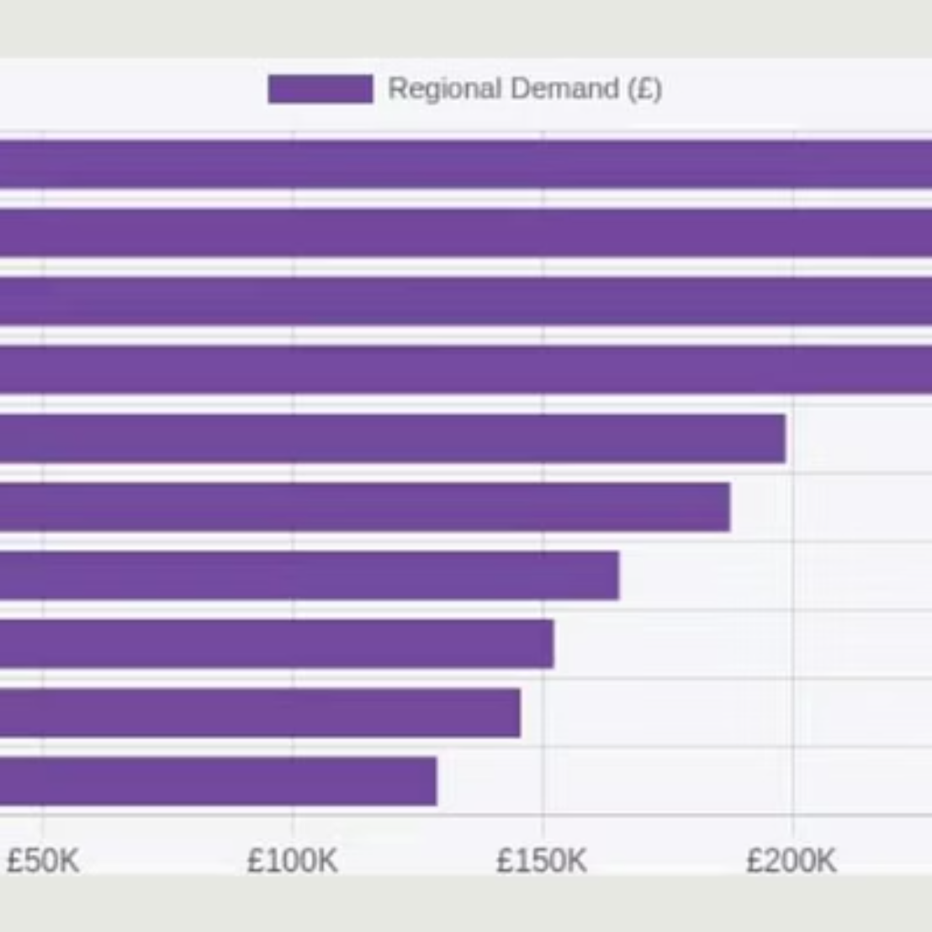
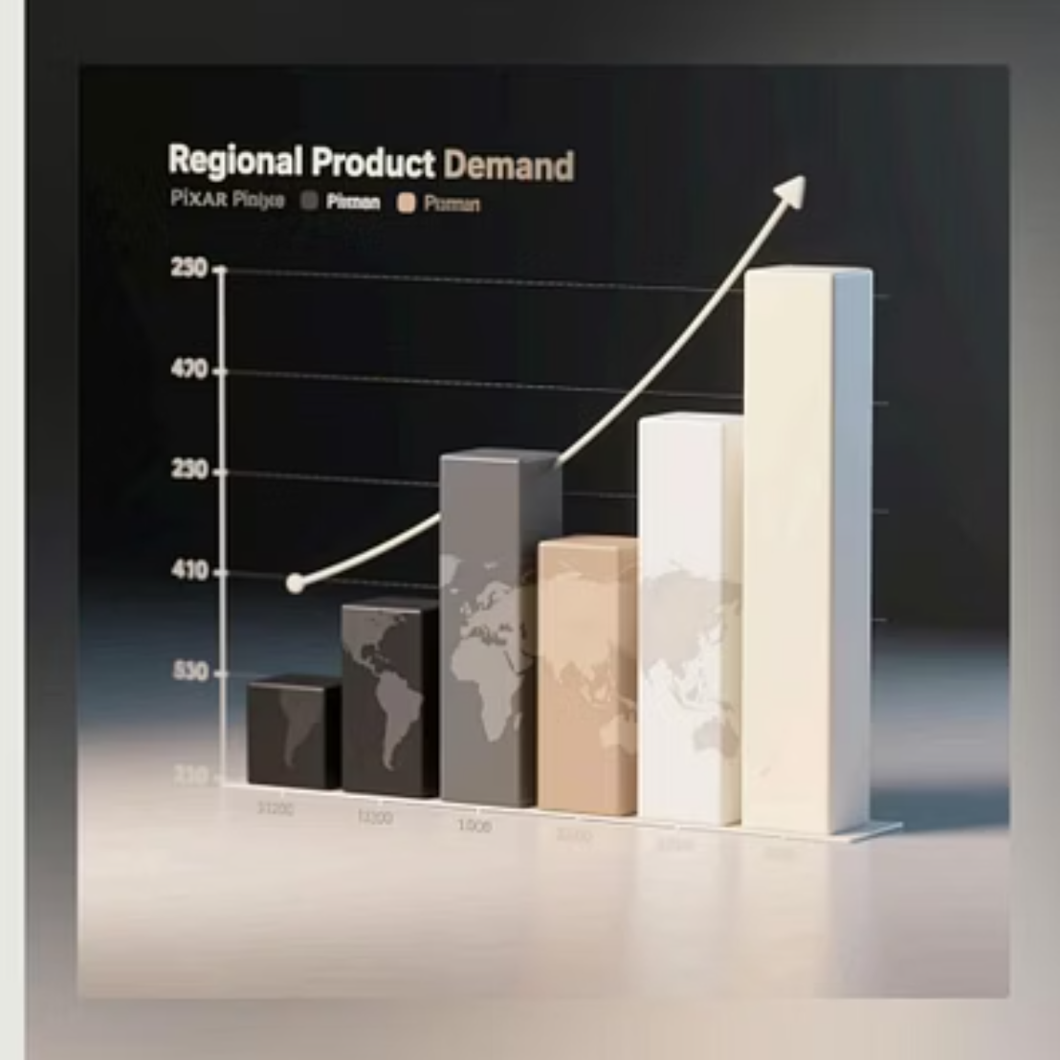
Regional Product Demand Analysis
Northern Europe demonstrates the strongest regional demand. Netherlands dominates, followed by EIRE, Germany, France, Sweden, Spain, Italy, Belgium, Poland and Switzerland.

Slide 6
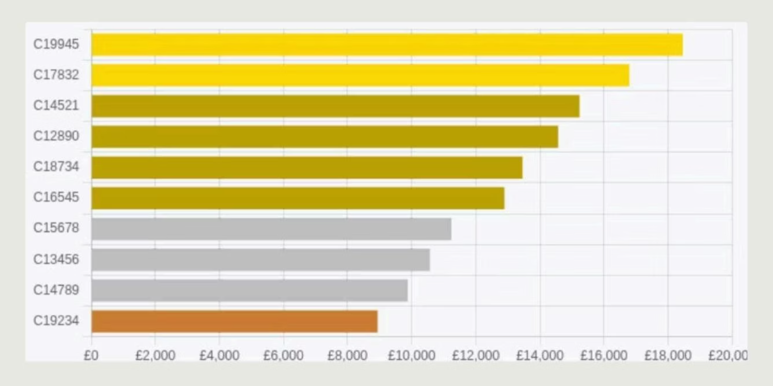
Top 10 Customers by Revenue
Customer C19945 leads the hierarchy with the highest revenue contribution. Platinum customers average £17,623 each, demonstrating strong customer value concentration.

Slide 7


Top Countries Detailed Metrics
Netherlands
£284,568 revenue
12,456 units | £22.84 avg
EIRE
£269,834 revenue
11,203 units | £24.08 avg
Germany
£256,789 revenue
10,834 units | £23.69 avg
France
£245,633 revenue
10,245 units | £23.97 avg

Slide 8
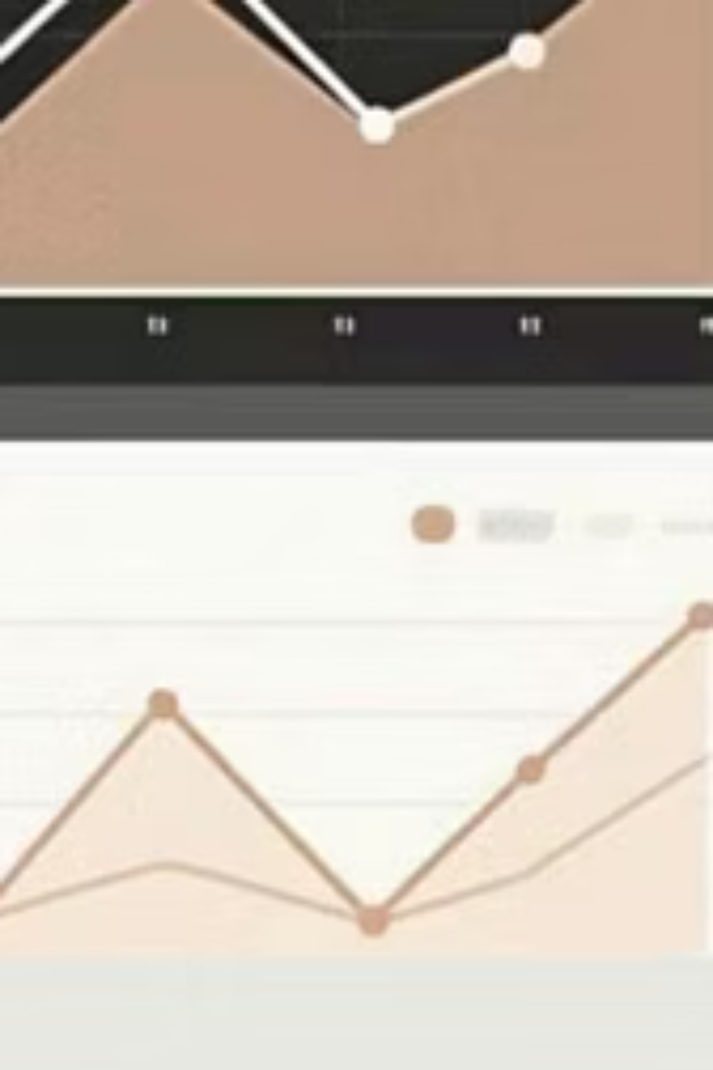

Mid-Tier Market Performance
Sweden
£198,765 revenue
8,912 units sold
£22.31 average order
Spain
£187,655 revenue
8,203 units sold
£22.88 average order
Italy
£165,433 revenue
7,456 units sold
£22.19 average order
Belgium
£152,348 revenue
6,834 units sold
£22.28 average order

Slide 9




Strategic Insights
Top 3 Countries Share
December Dip
46.6% of total revenue concentrated in Netherlands, EIRE and Germany
21% decline versus November requires strategic attention
Peak Season
Strongest Region
August to November (4 months) shows strongest performance period
Northern Europe dominates with consistent high-value orders

Slide 10

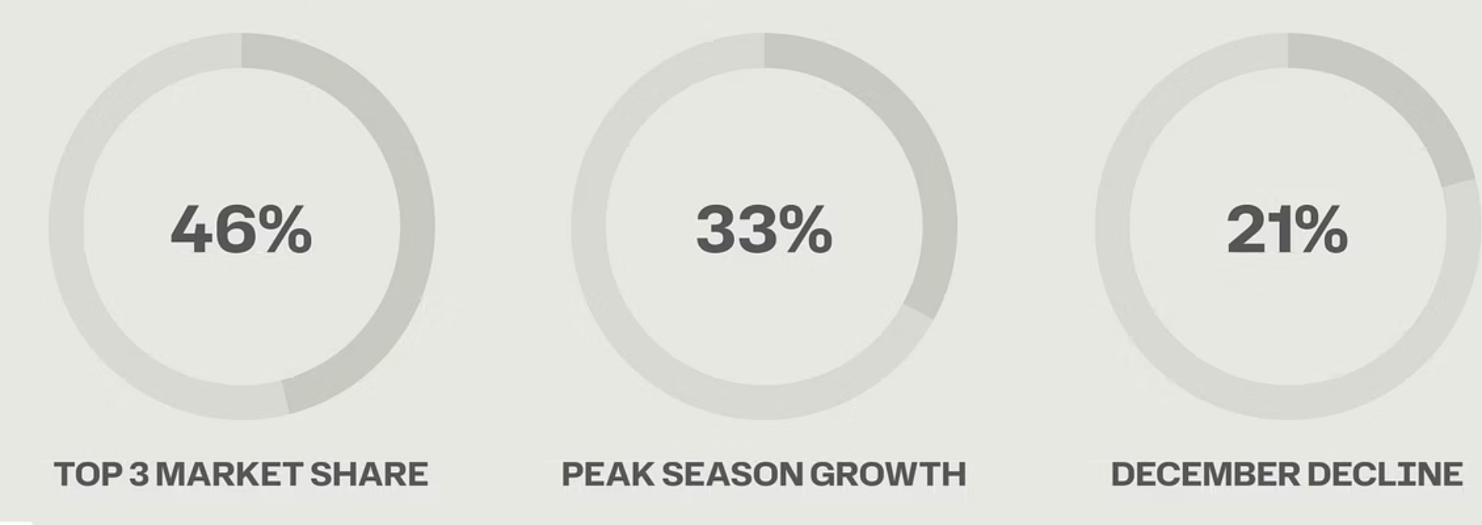
2011 Performance Summary
Data excludes United Kingdom | Generated: November 29, 2025

